Slide 1
Procedure for Changing the Loan Amount (APPROVAL)

Slide 2
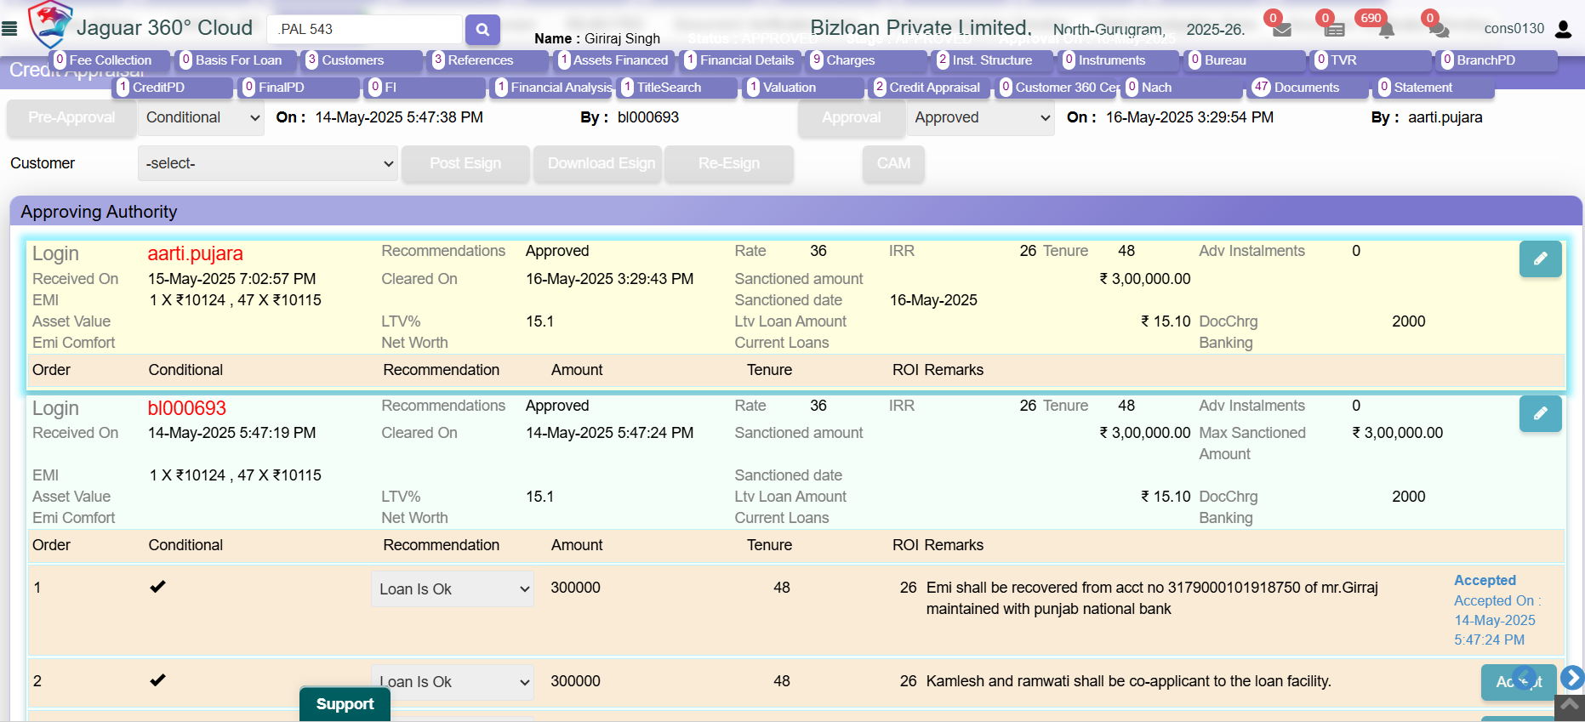
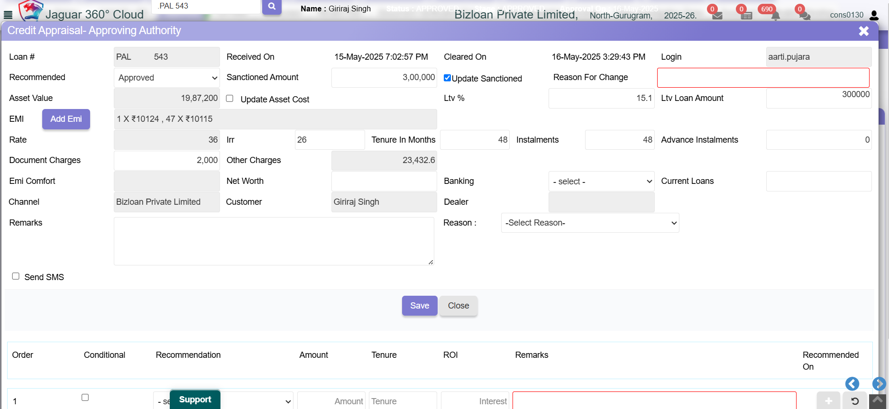
Step:- 1:- Update Credit Appraisal
Navigate to the Credit Appraisal section and click Edit Credit Appraisal.
Click the toggle button to enable editing of the Sanction Amount, and update it as per the revised terms.
Update the Tenure and Rate of Interest (ROI) according to the new conditions.
Click on the Add EMI button to auto-calculate the EMI based on the revised details.
Finally, click the Save button to confirm and save the changes.

Slide 3
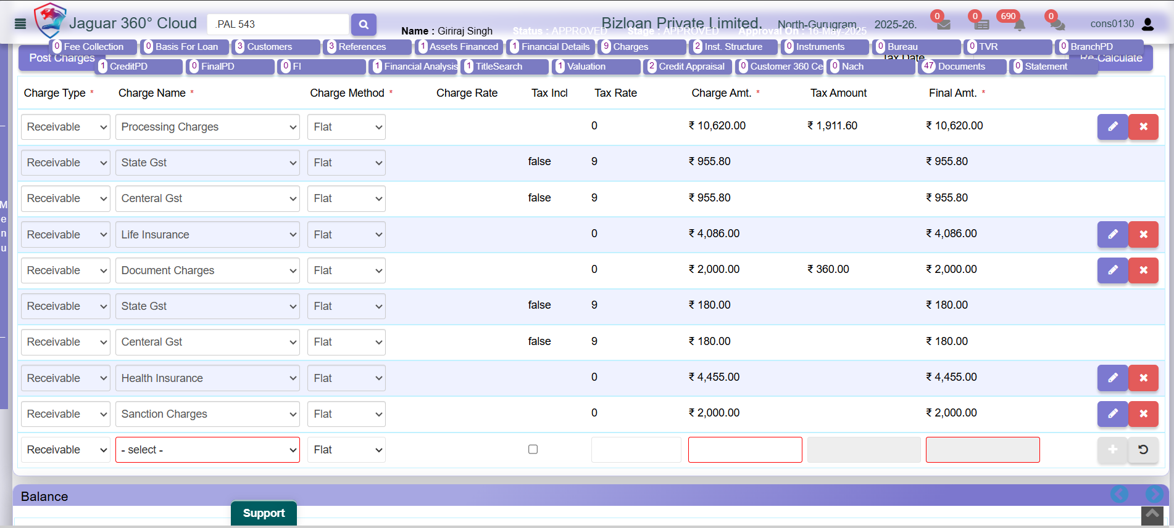
Step:- 2:- Update Fee Collection
Go to the Fee Collection section.
Update the following fields in line with the revised sanction amount:
  Processing Charges
  Insurance Charges

Slide 4
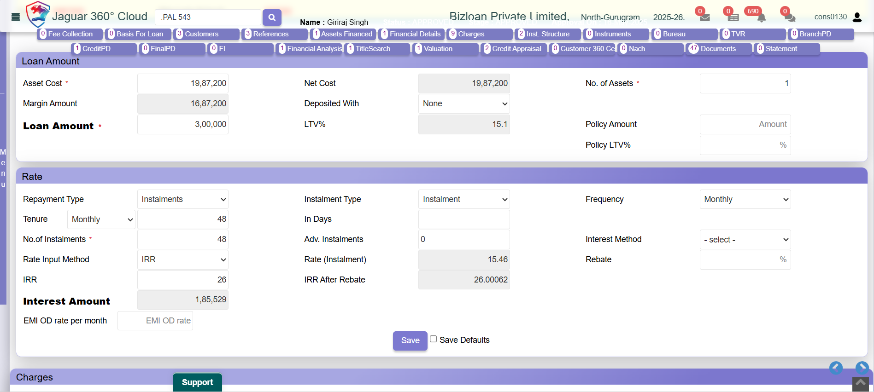
Step:- 3:- Update Financial Details
Navigate to the Financial Details section.
Update the following fields:
    Loan Amount
    Tenure
    Rate of Interest (ROI)
Verify that the EMI is accurately reflected based on the revised inputs.

Slide 5
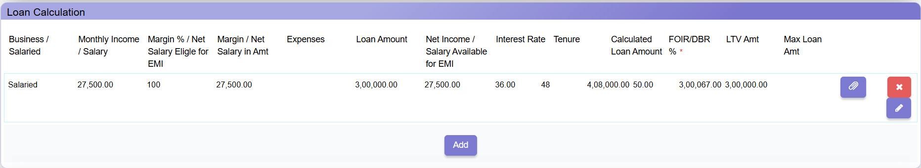
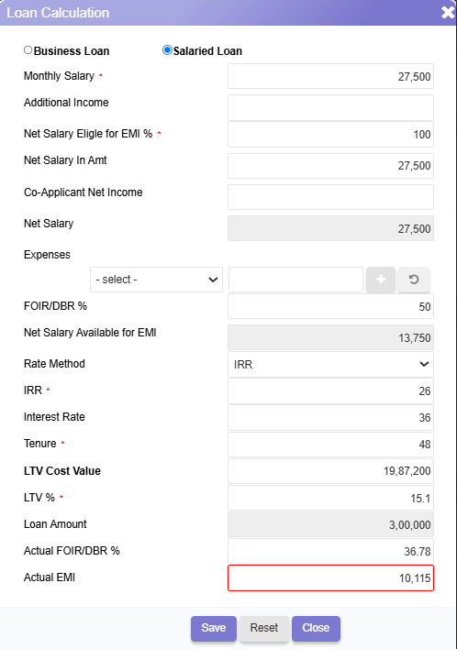
Step:- 4:- Financial Analysis
In the Financial Analysis section, the loan amount will automatically be updated based on the changes made in the Financial Details section.
Manually update the Tenure, ROI, and FOIR to match the revised terms.

